Slide 1


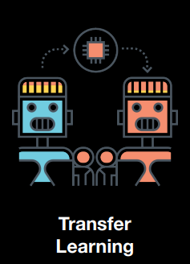
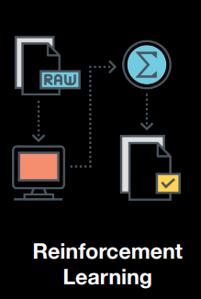
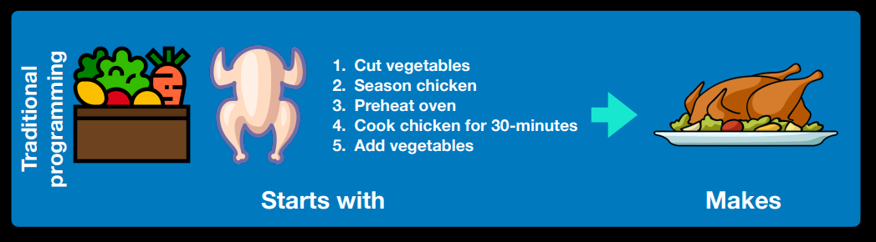
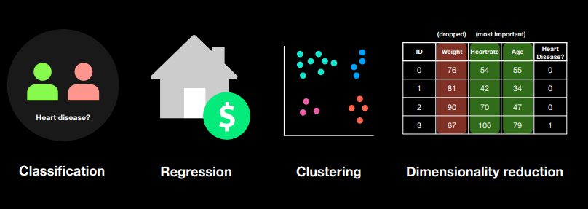
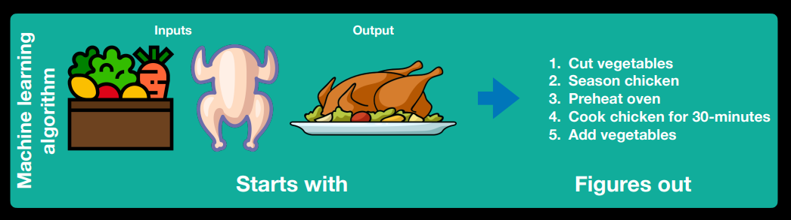

Q. What is Machine Learning?
Categories of learning:
A. Machine learning is turning things (data) into numbers and finding patterns in those numbers.
(does not require 2.0)
(requires 1.0)
Traditional programming (software 1.0) vs. Machine learning (software 2.0)
Problem domains:
Tech Stack:
Q. Why use machine learning?
Languages: Python, C++, SQL
A. Good reason: Why not?
AI/ML Libraries: TensorFlow, PyTorch
B. Better reason: Can you think of all the rules?
(probably not)
Other Libraries: NLTK, Pandas, Numpy, scipy, ffn, pyodbc ….
Tools/IDE: PyCharm, Jupyter, Anaconda
(maybe not very simple…)
Machine Learning Mathematics:
“If you can build a simple rule-based system that doesn’t require machine learning, do that.”
Linear Algebra
A wise software engineer… (actually rule 1 of Google’s Machine Learning Handbook)
Matrix Manipulation
What machine learning is good for
Problems with long lists of rules—when the traditional approach fails, machine learning may help.
Continually changing environments—machine learning can adapt (‘learn’) to new scenarios.
Discovering insights within large collections of data—can you imagine trying to go through every transaction your (large) company has ever had by hand?
Multivariate Calculus
The Chain Rule
Probability + Distributions
Optimization
Notes:
https://github.com/iammaniksharma/Machine-Learning/upload

Slide 2
Machine Learning Process
Continuous Process
Data Collection
Data Preparation
Train a Model
Evaluation
Serve Model
Retrain Model

